Slide 1
COMP 503:
Advanced Theory of Computation
Instructor: Sharoon Nasim
Office: S- 426 D

Slide 2
18.404 Course Outline
Computability Theory 1930s – 1950s
What is computable… or not?
Examples: program verification, mathematical truth
Models of Computation: Finite automata, Turing machines, …
Complexity Theory 1960s – present
What is computable in practice?
Example: factoring problem
P versus NP problem
Measures of complexity: Time and Space

Slide 3






Let’s begin: Finite Automata
0
1
$$M1$$
0,1
1
$$q3$$
$$q1$$
$$q2$$
0
Input: finite string Output: Accept or Reject
Computation process: Begin at start state, read input symbols, follow corresponding transitions, Accept if end with accept state, Reject if not.
Examples: 01101 → Accept 00101 → Reject
$M1$ accepts exactly those strings in $A$ where $A = \{w| w$contains substring $11\}.$
States: $q1 q2 q3$
Transitions:
Start state:
Accept states:
1
Say that $A$ is the language of $M1$ and that $M1$ recognizes $A$ and that $A = L(M1)$.

Slide 4











Finite Automata – Formal Definition
Defn: A finite automaton $M$ is a 5-tuple $(Q, Σ, δ, q0, F)$
$Q$ finite set of states
$Σ$ finite set of alphabet symbols
$δ$ transition function $δ: Q×Σ → Q$
$q0$ start state
$F$ set of accept states
Example:
$δ (q, a) = r$ means
$$q$$
a
$$r$$
0
$$M1$$
1
0,1
$$q1$$
$$q2$$
1
$$q3$$
0
$M1 = (Q, Σ, δ, q1, F)$
$Q = \{q1, q2, q3\}$
$Σ = \{0, 1\}$
$F = \{q3\}$
$$δ=$$
 | 0 | 1
$$q1$$ | $$q1$$ | $$q2$$
$$q2$$ | $$q1$$ | $$q3$$
$$q3$$ | $$q3$$ | $$q3$$
Notes:
Goal- Precise mathematical description

Slide 5
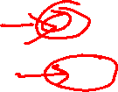

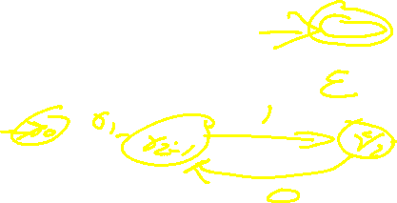

Finite Automata – Computation
Strings and languages
A string is a finite sequence of symbols in $Σ$
A language is a set of strings (finite or infinite)
The empty string ε is the string of length 0
The empty language $ø$ is the set with no strings
Defn: $M$ accepts string $w = w1w2 … wn$each $wi ε Σ$ if there is a sequence of states $r0, r1, r2, ,…, rn ε Q$ where: - $r0 = q0$ - $ri = δ(r_{i−1}, wi)$ for $1≤i≤n$ - $rn ε F$
Recognizing languages
$L(M) = \{w| M accepts w\}$
$L(M)$is the language of $M$
$M$ recognizes $L(M)$
Defn: A language is regular if some finite automaton recognizes it.

Slide 6






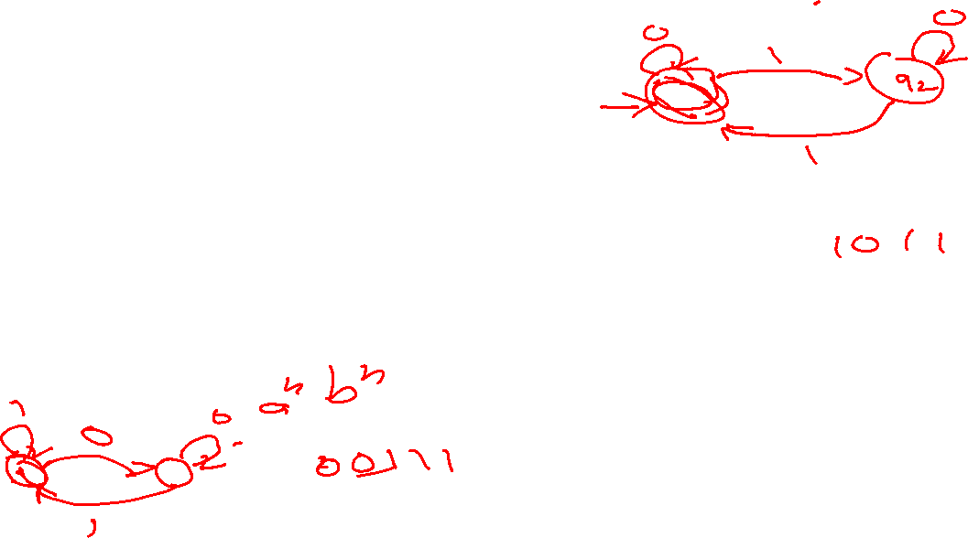

Regular Languages – Examples
$$M1$$
0
1
0,1
1
$$q3$$
$$q1$$
$$q2$$
0
More examples:
Let $B=\left\{w\right| w$has an even number of 1s$\}$ $B$ is regular (make automaton for practice).
Let $C=\left\{w\right| w$has equal numbers of 0s and 1s$\}$ $C$ is not regular (we will prove).
$L\left(M_{1}\right)= \{w| w contains substring 11\}=A$
Therefore $A$ is regular
Goal: Understand the regular languages

Slide 7




Regular Expressions
Regular operations. Let $A,B$ be languages:
Union: $A∪B=\left\{w\right| w∈A$ or $w∈B\}$
Concatenation: $A∘B=\left\{xy\right| x∈A$ and $y∈B\}=AB$
Star: $A^{∗}=\left\{x_{1}… x_{k}\right|$each$x_{i}∈A$ for $k≥0\}$ Note: $ε∈A^{∗}$ always
Example. Let $A=\{$good, bad$\}$ and $B=\{$boy, girl$\}$.
$A∪B=${good, bad, boy, girl}
$A∘B=AB=$ {goodboy, goodgirl, badboy, badgirl}
$A^{∗}=$ {$ε$, good, bad, goodgood, goodbad, badgood, badbad, goodgoodgood, goodgoodbad, … }
Regular expressions
Built from $Σ$, members $Σ, ∅,ε$ [Atomic]
By using $∪, ∘, ∗$ [Composite]
Examples:
${\left(0∪1\right)}^{∗}=Σ^{∗}$ gives all strings over $Σ$
$Σ^{∗}1$ gives all strings that end with 1
$Σ^{∗}11Σ^{∗}=$all strings that contain 11 $=L\left(M_{1}\right)$
Goal: Show finite automata equivalent to regular expressions

Slide 8

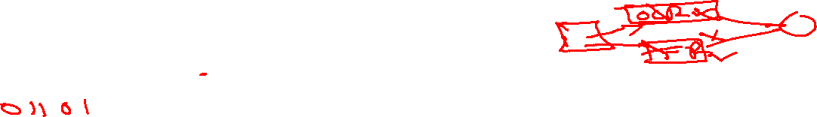








Closure Properties for Regular Languages
Theorem: If ${ A}_{1}, A_{2}$are regular languages, so is $A_{1}∪A_{2}$ (closure under $∪$)
Proof: Let $M_{1}=(Q_{1}, Σ, { δ}_{1}, { q}_{1}, { F}_{1})$ recognize $A_{1}$ $M_{2}=(Q_{2}, Σ, { δ}_{2}, { q}_{2}, { F}_{2})$ recognize $A_{2}$
Construct $M = (Q, Σ, δ, q0, F)$ recognizing ${A_{1}∪A}_{2}$ $M$ should accept input $w$ if either $M_{1}$ or $M_{2}$ accept $w$.
Check-in 1.1
In the proof, if $M_{1}$ and $M_{2}$ are finite automata where $M_{1}$ has $k_{1}$ states and $M_{2}$ has$k_{2}$ states
Then how many states does $M$have?
(a) $k_{1}+k_{2}$
(b) ${\left(k_{1}\right)}^{2}+{\left(k_{2}\right)}^{2}$
(c) $k_{1}×k_{2}$
Components of $M$:
$Q=Q_{1}×Q_{2}$ $=\left\{\left(q_{1},q_{2}\right)\right|q_{1}∈Q_{1}$ and $q_{2}∈Q_{2}\}$
$q_{0}=(q_{1}, q_{2})$
$δ\left(\left(q,r\right),a\right)=\left(δ_{1}\left(q,a\right),δ_{2}\left(r,a\right)\right)$
$F=F_{1}×F_{2}$
$F=\left(F_{1}×Q_{2}\right)∪\left(Q_{1}×F_{2}\right)$
$$M_{1}$$
$$q$$
$$M$$
?
$$q,r$$
$$M_{2}$$
NO! [gives intersection]
$$r$$
Check-in 1.1

Slide 9







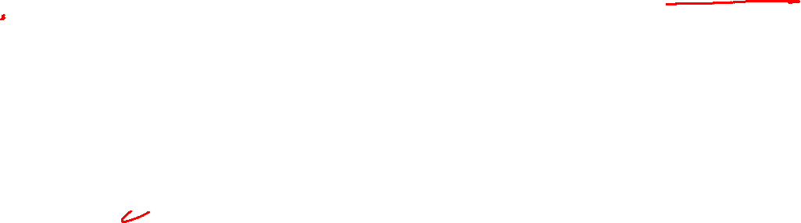



Closure Properties continued
Theorem: If ${ A}_{1}, A_{2}$are regular languages, so is $A_{1}A_{2}$ (closure under $∘$)
Proof: Let $M_{1}=(Q_{1}, Σ, { δ}_{1}, { q}_{1}, { F}_{1})$ recognize $A_{1}$ $M_{2}=(Q_{2}, Σ, { δ}_{2}, { q}_{2}, { F}_{2})$ recognize $A_{2}$
Construct $M = (Q, Σ, δ, q0, F)$ recognizing ${A_{1}A}_{2}$
$$M_{1}$$
$$M_{2}$$
$M$ should accept input $w$ if $w=xy$ where $M_{1}$ accepts $x$ and $M_{2}$ accepts $y$.
$$M$$
$$w$$
$$x$$
$$y$$
Doesn’t work: Where to split $w$?

Slide 10
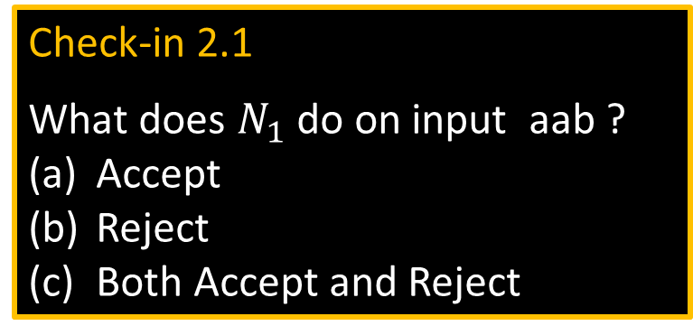



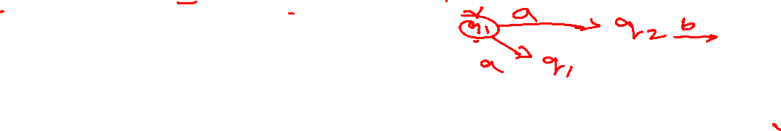
Nondeterministic Finite Automata
$$N1$$
a
a
b
a,ε
$$q4$$
$$q1$$
$$q2$$
$$q3$$
b
New features of nondeterminism: - multiple paths possible (0, 1 or many at each step)
- ε-transition is a “free” move without reading input
- Accept input if some path leads to accept
Example inputs:
- ab accept
- aa reject
- aba accept
- abb reject
Check-in 2.1
What does $N_{1}$ do on input aab ?
Accept
Reject
Both Accept and Reject
Nondeterminism doesn’t correspond to a physical machine we can build. However, it is useful mathematically.
Check-in 2.1

Slide 11


NFA – Formal Definition
$$N1$$
a
a
b
a,ε
$$q4$$
$$q1$$
$$q2$$
$$q3$$
b
Defn: A nondeterministic finite automaton (NFA) $N$ is a 5-tuple $(Q, Σ, δ, q0, F)$
- all same as before except $δ$
- $δ:Q×Σ_{\text{ε}}→𝓟\left(Q\right)=\left\{R\right|R⊆Q\}$
- In the $N_{1}$ example: $δ\left(q_{1},\text{a} \right)=\{q_{1},q_{2}\}$
$δ\left(q_{1},\text{b} \right)= ∅$
Ways to think about nondeterminism:
Computational: Fork new parallel thread and accept if any thread leads to an accept state.
Mathematical: Tree with branches. Accept if any branch leads to an accept state.
Magical: Guess at each nondeterministic step which way to go. Machine always makes the right guess that leads to accepting, if possible.
states
alphabet
start state
accept states
transition function
power set
$$Σ∪\{\text{ε}\}$$

Slide 12









Converting NFAs to DFAs
Theorem: If an NFA recognizes $A$ then $A$ is regular
Proof: Let NFA $M=(Q, Σ,δ, { q}_{0}, F)$ recognize $A$ Construct DFA $M′=(Q′, Σ,δ′, { q}_{0}^{′}, F′)$ recognizing $A$
(Ignore the ε-transitions, can easily modify to handle them)
IDEA: DFA $M′$ keeps track of the subset of possible states in NFA $M$.
Check-in 2.2
If $M$ has $n$ states, how many states does $M′$ have by this construction?
$2n$
$n^{2}$
$2^{n}$
$$M′$$
Construction of $M′$:
$Q′=𝓟\left(Q\right)$
$δ^{′}\left(R,a\right)=\left\{q\right| q∈δ(r,a)$ for some $r∈R\}$
$q_{0}^{′}=\{q_{0}\}$
$F′=\left\{R∈Q^{′}\right| R$ intersects $F\}$
$$M$$
$${ q}_{3}$$
${ \{q}_{3}$,$q_{7}\}$
$R∈Q′$
$${ q}_{7}$$
NFA
DFA
Check-in 2.2

Slide 13
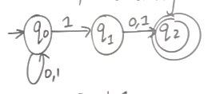
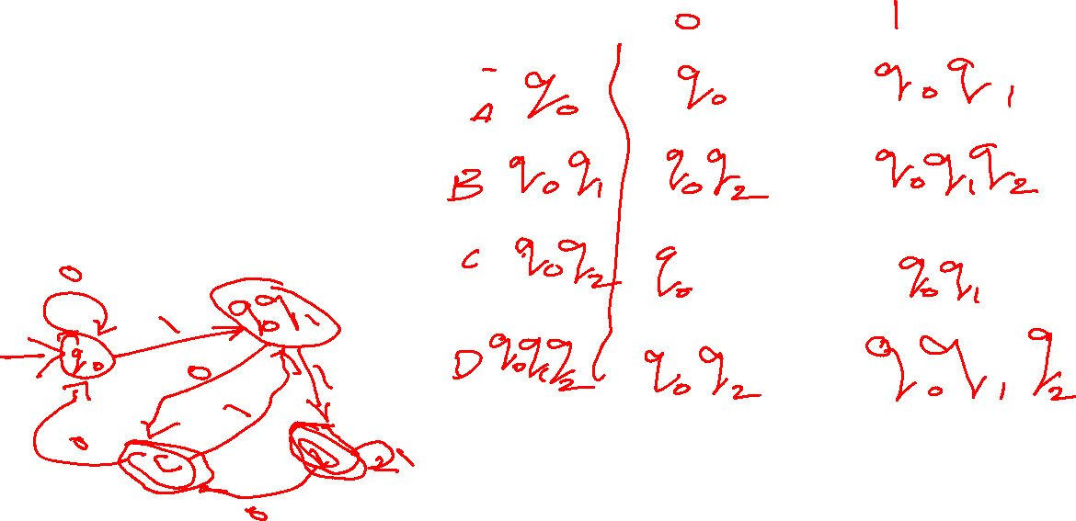
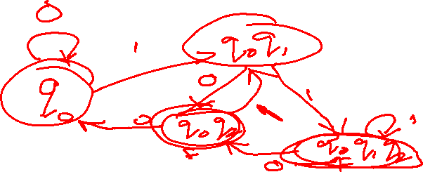
NFA TO DFA

Slide 14




Return to Closure Properties
Recall Theorem: If $A_{1}, A_{2}$are regular languages, so is $A_{1}∪A_{2}$ (The class of regular languages is closed under union)
New Proof (sketch): Given DFAs $M_{1}$ and $M_{2}$ recognizing $A_{1}$ and$A_{2}$ Construct NFA $M$ recognizing $A_{1}∪A_{2}$
$$M$$
$$M_{1}$$
Nondeterminism parallelism vs guessing
ε
$$M_{2}$$
ε

Slide 15



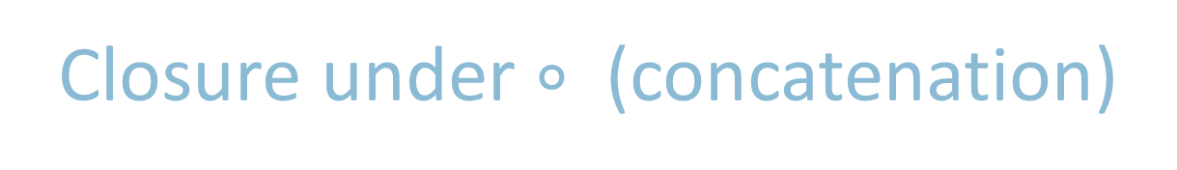





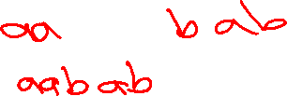

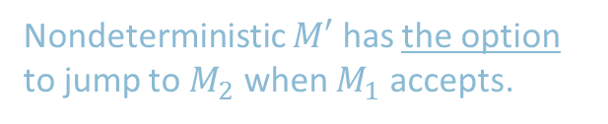
Closure under $∘$ (concatenation)
Theorem: If $A_{1}, A_{2}$are regular languages, so is $A_{1}A_{2}$
Proof sketch: Given DFAs $M_{1}$ and $M_{1}$ recognizing $A_{1}$ and$A_{2}$ Construct NFA $M$ recognizing $A_{1}A_{2}$
$$M$$
$$M_{1}$$
$$M_{2}$$
ε
$M$ should accept input $w$ if $w=xy$ where $M_{1}$ accepts $x$ and $M_{2}$ accepts $y$.
ε
$$w=$$
$$x$$
$$y$$
Nondeterministic $M′$ has the option to jump to $M_{2}$ when $M_{1}$ accepts.

Slide 16
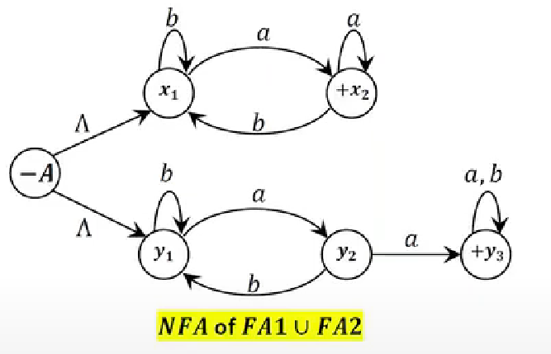
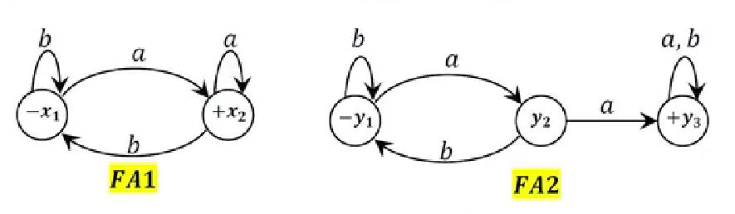
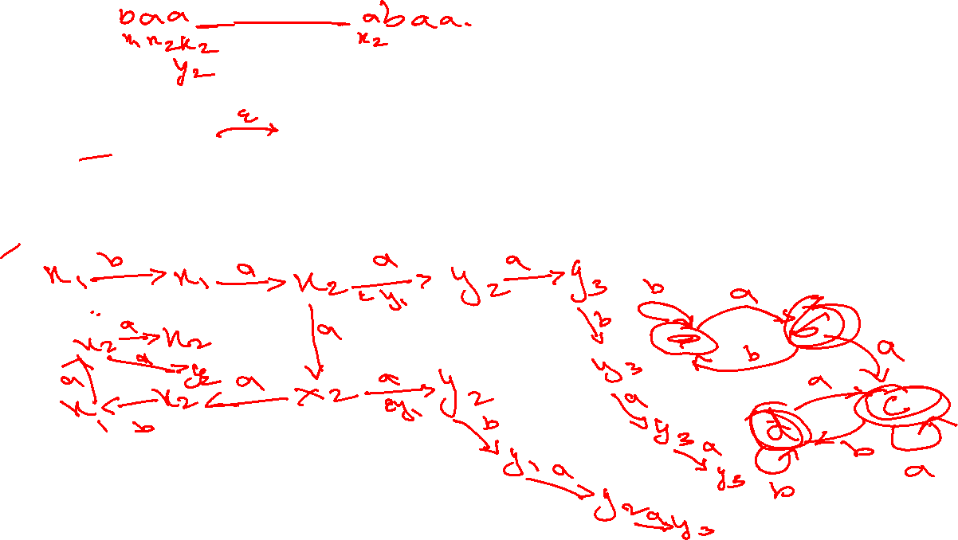


Slide 17












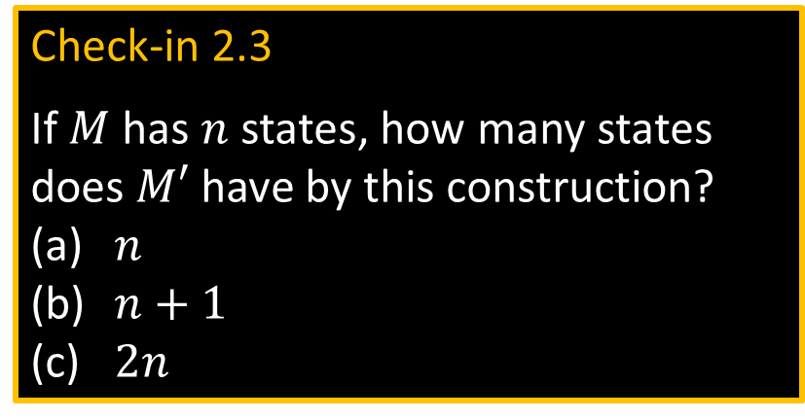
Closure under $∗$ (star)
Theorem: If $A$ is a regular language, so is $A^{∗}$
Proof sketch: Given DFA $M$ recognizing $A$ Construct NFA $M′$ recognizing $A^{∗}$
$$M′$$
Check-in 2.3
If $M$ has $n$ states, how many states does $M′$ have by this construction?
$n$
$n+1$
$2n$
$$M$$
ε
$M′$ should accept input $w$
if $w=x_{1}x_{2} … x_{k}$
where $k≥0$ and $M$ accepts each $x_{i}$
ε
ε
$$w=$$
$$x_{1}$$
$$x_{2}$$
$$x_{3}$$
$$x_{4}$$
Make sure $M′$ accepts ε
Check-in 2.3

Slide 18
Regular Expressions $→$ NFA
Theorem: If $R$ is a regular expr and $A=L\left(R\right)$ then $A$ is regular
Proof: Convert $R$ to equivalent NFA $M$:
If $R$ is atomic:
$R=a$ for $a∈Σ$
$R=ε$
$R=∅$
If $R$ is composite:
$R=R_{1}∪R_{2}$
$R=R_{1}∘R_{2}$
$R=R_{1}^{∗}$
Equivalent $M$ is:
$$a$$
Example:
Convert ${\left(\text{a}∪\text{ab}\right)}^{∗}$ to equivalent NFA
$\text{a}$:
$\text{b}$:
$\text{ab}$:
$\text{a}∪\text{ab}$:
${\left(\text{a}∪\text{ab}\right)}^{∗}$:
$$\text{a}$$
$$\text{b}$$
$$\text{a}$$
$$ε$$
$$\text{b}$$
}
$$ε$$
$$\text{a}$$
$$\text{a}$$
$$ε$$
$$\text{b}$$
Use closure constructions
$$ε$$
$$ε$$
$$ε$$
$$\text{a}$$
$$ε$$
$$\text{a}$$
$$ε$$
$$\text{b}$$
$$ε$$
$$ε$$

Slide 19
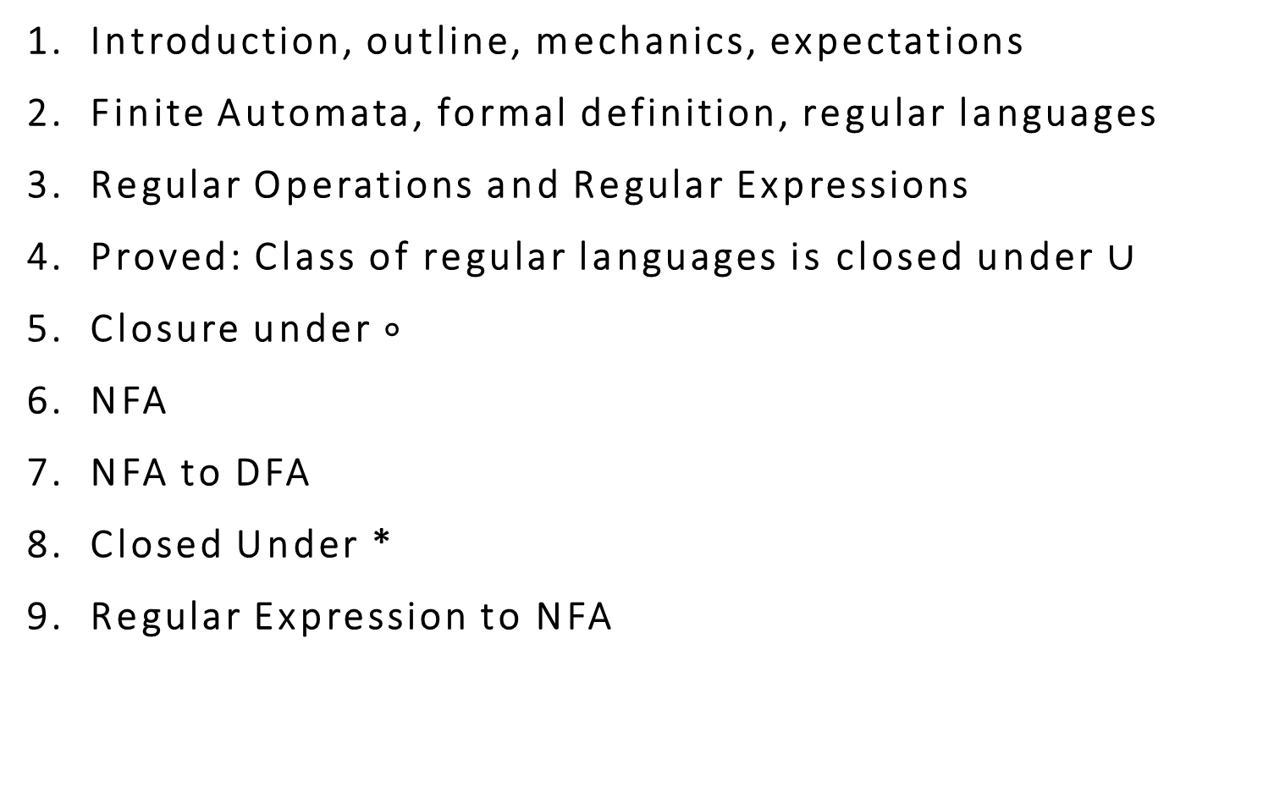
Quick review of today
Introduction, outline, mechanics, expectations
Finite Automata, formal definition, regular languages
Regular Operations and Regular Expressions
Proved: Class of regular languages is closed under $∪$
Closure under $∘$
NFA
NFA to DFA
Closed Under *
Regular Expression to NFA

